Slide 1

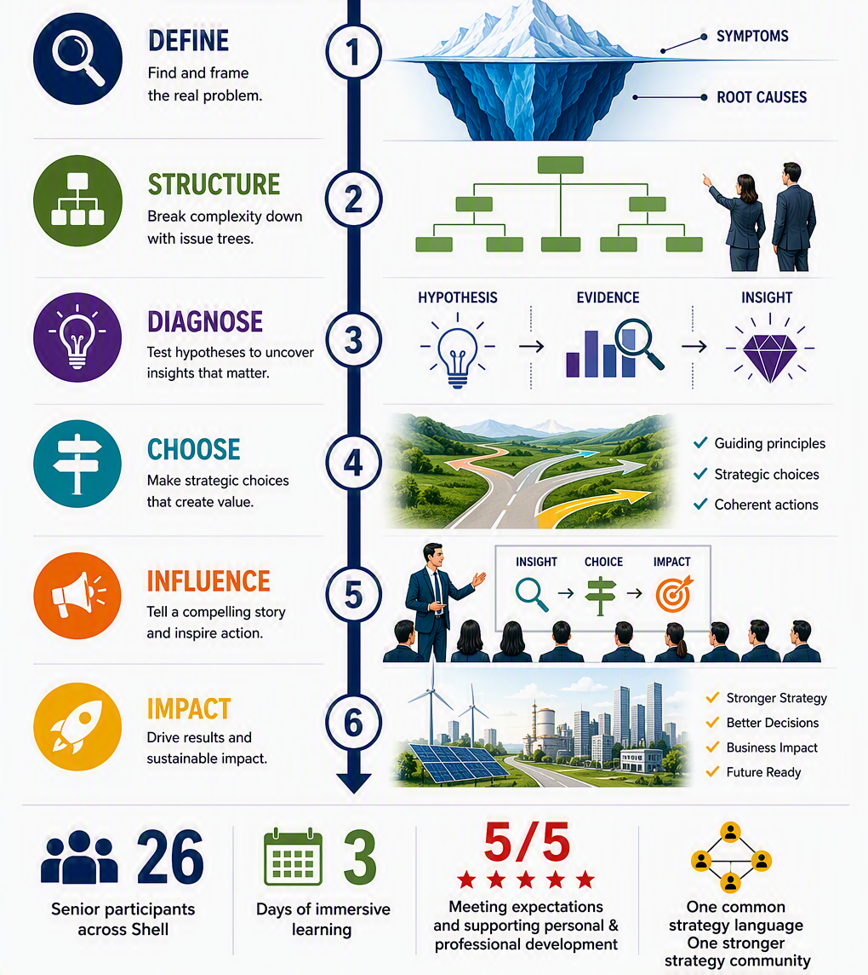
COLLABORATION & LEARNING
Mastering Strategy
Building world-class strategic thinkers
SHAPE
CONNECT
ACCELERATE
Emanuela Negro & Lara Thomsen
SCA Global Team F2F 2026 | 7–8 September

